Slide 1
Plymouth Parent Carer Voice SEND Conference
Keith Thompson, Regional Professional SEND Adviser – 15th June 2022

Slide 2
Objectives
Highlight some key SEND facts and challenges.
Provide information on the aims of the Green Paper
Focus on some of the Green Paper proposals
Encourage your response(s) to the consultation questions – closing date 22nd July 2022

Slide 3
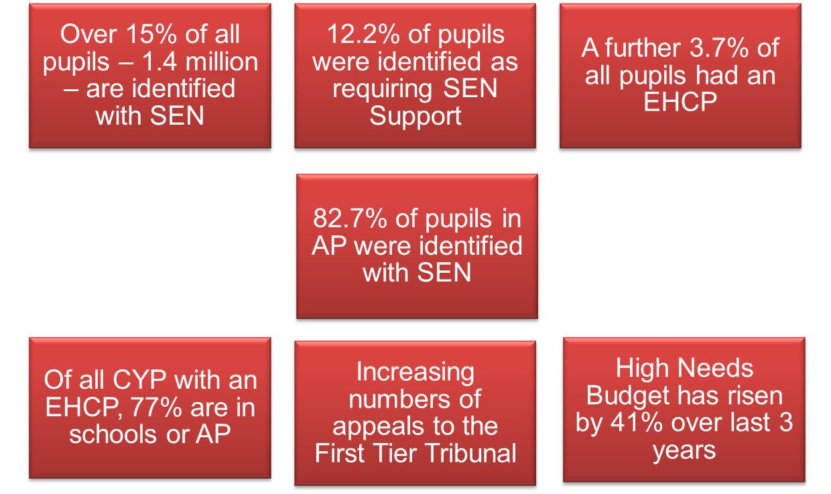
Key Facts
13.6% of pupils were identified as requiring SEN Support and
3.7% had an EHCP
Over 17% of pupils in Plymouth are identified with SEN

Slide 4
Three Challenges
1. Outcomes for children and young people with SEND or in alternative provision on average are poor.
2. Navigating the SEND system and alternative provision is not a positive experience for children, young people and their families.
3. Despite unprecedented investment, the system is not delivering value for money for children, young people and families.
Leading to:
A vicious cycle of late intervention, low confidence and inefficient resource allocation is driving these challenges.

Slide 5
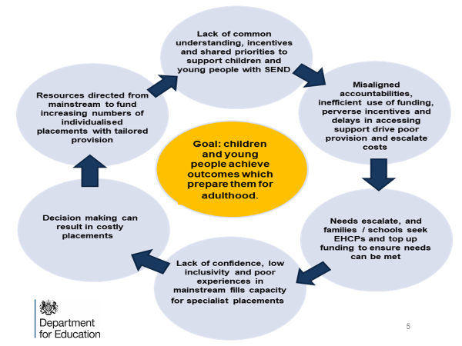

Slide 6
A Vicious Cycle
Inconsistency in the identification of needs and how they are met.
Lack of clarity for families on what they should reasonable expect from mainstream settings, resulting in a loss of confidence in these settings and seeking remedy through EHCPs.
Increasing requests for specialist placements has led to significant delays in CYP accessing support.
Financial resources and workforce capacity is pulled to the specialist end of the system, so less available to deliver timely and effective early interventions.
Poor experiences and outcomes for CYP with SEND continue, as costs increase.

Slide 7
Overall aim is to:
Create a more inclusive education system with excellent local mainstream provision which will improve the experience and outcomes for children and young people with special educational needs and those who need alternative provision.

Slide 8
Propose to do this by creating:

Slide 9
Key Proposals (I) – SEN and AP Green Paper
Consistent national standards will facilitate a more inclusive system, with more CYP able to have their needs met in high-quality mainstream provision with high aspirations, a confident and expert workforce and access to high-quality targeted support as needed.
How needs should be identified and assessed
Appropriate provision to be made available for different types of need
Standardised processes for accessing and reviewing support
Standards for co-producing and communicating with children, young people, parents and carers
Standards for transition
What key factors should be considered when developing national standards to ensure they deliver improved outcomes and experiences for children and young people with SEND and their families?

Slide 10
Key proposals (II) – SEN and AP Green Paper
Establish new local SEND partnerships, bringing together education, health and care partners with local government to produce a local inclusion plan setting out how each local area will meet the national standards for provision, processes and systems
How should we develop the proposal for new local SEND partnerships to oversee the effective development of local inclusion plans whilst avoiding placing unnecessary burdens or duplicating current partnerships?

Slide 11
Key proposals (III)
Mandating the use of local multi-agency panels in the EHC needs assessment process
Standardising EHCPs to ensure consistent access to specialist provision
Digitising EHCPs to reduce bureaucracy
What components of the EHCP should we consider reviewing or amending as we move to a standardised and digitised version?

Slide 12
Key proposals (IV)
Support parents to express an informed preference for a suitable placement by providing a list of settings drawn from the local inclusion plan.
Streamline the redress process, aiming to resolve disputes earlier, including through mandatory mediation.
How can parents and LAs most effectively work together to produce a tailored list of placements that is appropriate for their child, and gives parents confidence in the EHCP process?

Slide 13
Excellent provision from early years to adulthood
Increase the total investment in schools budgets by £7b by 2024-25, with an additional £1b in 2022-23 for high needs.
Consult on introducing a new SENCo National Professional Qualification (NPQ) for school SENCos.
Increase the number of staff with an accredited Level 3 SENCo qualification in early years settings.
Commission analysis to better understand the support that CYP with SEND need from the health workforce.
To what extent do you agree or disagree that we should introduce a new mandatory SENCo NPQ to replace the NASENCo? Why?

Slide 14
Excellent provision from early years to adulthood
Fund up to than 10,000 additional respite placements through an investment of £30m.
£82m to create a network of Family Hubs.
Invest £2.6 billon to deliver new places and improve existing provision for CYP with SEND or who need AP.
Invest £18m over the next 3 years to build capacity in the Supported Internships Programme.
Improve transitions at FE by introducing Common Transfer Files alongside piloting the roll out of adjustment passports.

Slide 15
A reformed and integrated role for alternative provision (AP)
Local SEND partnerships to deliver an AP service
Focus on early intervention
LAs to create an alternative-provision-specific budget
A bespoke performance framework for AP, focused on progress and re-integration into mainstream
A clear, tiered package of support from AP
Targeted support for children in mainstream;
Time-limited placements in AP with a return to original school;
Transitional placements for children to transition to a different school or to a suitable post-16 destination.
A call for evidence on the use of unregistered provision
More children and young people will remain in mainstream schools, improving their experience, wellbeing, and outcomes

Slide 16
Accountability, system roles, funding reform (I)
Deliver clarity in roles and responsibilities with every partner having a clear role to play, and having the levers to fulfil their responsibilities
DfE’s new Regions Group to take responsibility for holding LAs and Multi Academy Trusts (MATs) to account for delivering for SEND
Provide statutory guidance to Integrated Care Boards (ICBs) to set out clearly how to discharge their SEND statutory responsibilities
Ofsted/CQC to deliver an updated Local Area SEND Inspection Framework

Slide 17
Accountability, system roles, funding reform (II)
New inclusion dashboards for 0-25 provision, providing a timely, local and national, picture of how the system is performing
New national framework of banding and price tariffs, matched to levels of need and types of education provision set out in the national standards
What are the key metrics we should capture and use to measure local and national performance?
How can we best develop a national framework for funding bands and tariffs to achieve our objectives and mitigate unintended consequences and risks?

Slide 18
Delivering change for children and families
Publish a national SEND and AP delivery plan – setting out our response to this Green Paper and how reforms will be implemented
Establish a new National SEND Delivery Board to bring together national delivery partners across education, health and care and hold them to account
What will make the biggest difference to successful implementation of these proposals?
What do you see as the barriers to and enablers of success?

Slide 19
Delivering change for children and families
Stabilise local SEND systems by investing an additional £300m in the Safety Valve Programme and £85m in the Delivering Better Value (DBV) programmes, over 3 years, to support LAs with the biggest deficits.
DfE to work with system leaders from education, health and care and DHSC to develop the national SEND standards.
Support delivery through a £70m SEND and AP Reform change programme to test and refine key proposals and support local SEND systems.

Slide 20
22 Consultation questions
All resources are available on GOV.UK and include:
a full British Sign Language (BSL) version
an easy-read version to support those with learning disabilities
a guide for children and young people with SEND or those in AP
Closes at
11:45pm on Friday 22 July 2022
Please respond!

