Slide 1


The Keyworker Pilot

Slide 2

Introduction
Background
The NHS Long Term Plan committed
to provide a key worker to children
and young people with a Learning
Disability, Autism or both who have complex
needs.
Notes:
commitment that by 2023/24, this group with the most complex needs will have a designated Key Worker. 13 pilot sites all set up slightly differently and hosted in different services.

Slide 3
Introduction
Background
This was as a result of investigations
and reports which have evidenced
that young people with these diagnoses
often do not have good outcomes when
admitted to Tier 4 mental health hospitals; therefore
admission needs to be avoided unless it is absolutely
necessary.
Notes:
commitment that by 2023/24, this group with the most complex needs will have a designated Key Worker. 13 pilot sites all set up slightly differently and hosted in different services.

Slide 4
Introduction
Aims
To provide the right support, in the right place, at the right time.
To challenge systems and support parents to navigate them.
To keep young people out of Tier 4 hospital and in their local area.
The keyworker is an addition to the support that is already in place and not a replacement.
Notes:
commitment that by 2023/24, this group with the most complex needs will have a designated Key Worker. 13 pilot sites all set up slightly differently and hosted in different services.

Slide 5
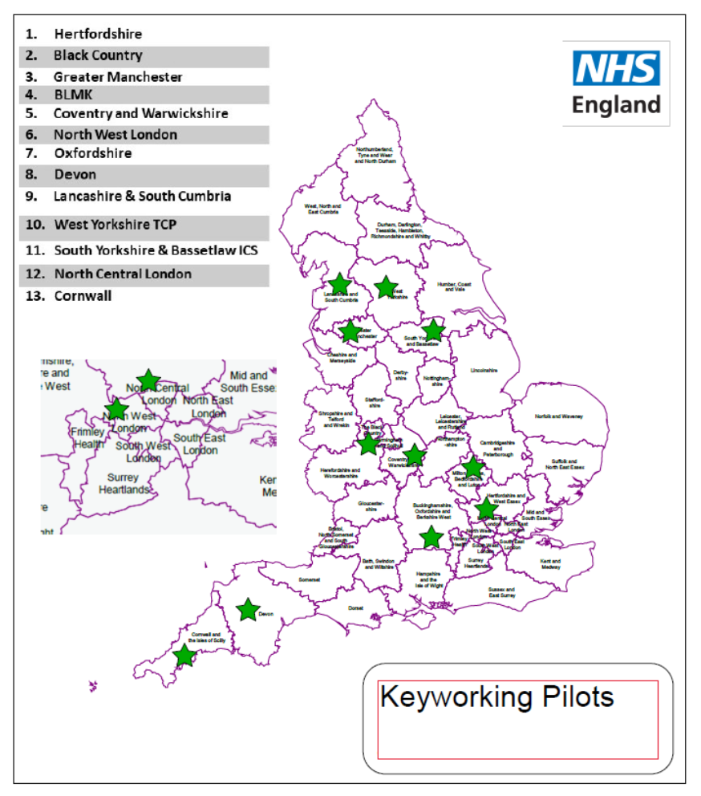
Introduction
The Keyworker Pilot
Models have varied team
structure and skill mix.
Teams located in Health,
voluntary sector and LA.
Age range includes 0-18,
0-18+ or 0-25 years.
Notes:
commitment that by 2023/24, this group with the most complex needs will have a designated Key Worker. 13 pilot sites all set up slightly differently and hosted in different services.

Slide 6
The Devon Pilot
Alongside our colleagues in Devon we were awarded the pilot - initially for 18 months - but now extended to Early Adopter Sites and soon will be across the country.
Notes:
Specific criteria and placed on red, amber or yellow depending on level of need. Can move up or down the ratings. Identifies those at risk so we should know about them before it reaches crisis and hospital admission.
Fortnightly meetings to discuss all young people and ensure we are working collaboratively and moving forward with care and support

Slide 7
The Dynamic Support Register
A RAG rated ‘at risk’ register for young people with Autism and / or Learning Disabilities who are either in a Tier 4 mental health setting or at risk of being admitted to a Tier 4 mental health setting.
Identifies those at risk earlier.
Notes:
Specific criteria and placed on red, amber or yellow depending on level of need. Can move up or down the ratings. Identifies those at risk so we should know about them before it reaches crisis and hospital admission.
Fortnightly meetings to discuss all young people and ensure we are working collaboratively and moving forward with care and support

Slide 8




Dynamic Support Register (DSR) Referral criteria for Young people with a confirmed diagnosis of Autism and/or Intellectual disability (LD)
The Dynamic Support Register provides a list of Young people who may be at risk of admission to a mental health hospital or a 52 week placement. The Key Working Team currently support Young people, their families, carers and guardians who meet the RED and Amber criteria on the DSR.
The DSR criteria is a clinical tool, used to support a greater understanding of the Young Persons risk of admission to hospital, ensuring that the appropriate services and support are targeted to meet the needs of the Young person and their family at a time when they most need it.
RED – Admitted to, or at immediate risk (within 48 hours) of admission to a Mental Health hospital or 52 week placement.
AMBER – Discharge from a Mental Health Hospital or at Imminent risk (within 2 weeks) of admission to a Mental Health Hospital or 52 week placement.
Breakdown in home placement that may lead to an inappropriate admission to hospital or 52 week placement.
Yellow- At risk of home placement breakdown alongside a significant escalation in need and support from statutory services (Health, Education and Social care). Consideration that if YP needs are not met appropriately in the community and future admission to a mental health hospital and or 52 week placement may be considered.

Slide 9
The Dynamic Support Register
Keyworkers now allocated to all young people that are rated RED and AMBER.
The YELLOW section is for young people that are starting to cause concern but do not meet the criteria for RED or AMBER. We do not allocate a keyworker to the young people on the yellow section.
The DSR (red and amber) gets sent every month to specialists in the Learning Disability and Autism Programme (LDAP) clinical commissioning team who help services to ensure young people are receiving the most appropriate care.
We also attend fortnightly tracker meetings with the CCG, health and social care.
Notes:
Specific criteria and placed on red, amber or yellow depending on level of need. Can move up or down the ratings. Identifies those at risk so we should know about them before it reaches crisis and hospital admission.
Fortnightly meetings to discuss all young people and ensure we are working collaboratively and moving forward with care and support

Slide 10
The Teams
Plymouth Team
Devon Team
Team manager
Business Administrator Vacancy
Team Manager
Business Administrator
Vacancy
Advanced Practitioner
Advanced Practitioner
Senior Practitioner
Senior Practitioner
Assistant Practitioner
Assistant Practitioner
Assistant Practitioner
Assistant Practitioner​
Notes:
Recommendation 7, Page 20 of These Are Our Children

Slide 11
What do we actually do??
Notes:
Specific criteria and placed on red, amber or yellow depending on level of need. Can move up or down the ratings. Identifies those at risk so we should know about them before it reaches crisis and hospital admission.
Fortnightly meetings to discuss all young people and ensure we are working collaboratively and moving forward with care and support

Slide 12
Participation
Co production between Plymouth and Devon.
Young people supporting interview process.
Representative from PCV sitting on interview panel.
Monthly participation meetings.
National Keyworking Steering Group.
Notes:
Participation groups – professionals, parents and young people

Slide 13
Evaluation
Outcome Star.
Monthly data fed back to the CCG.
Feedback from colleagues.
Notes:
Outcome star is

Slide 14








Initial difficulties
Starting without a full team and staggered start dates.
Clarity around criteria for DSR.
Gaps are identified in the system; eg transitioning to adults services, placements, education provisions.
Understanding of our role; LDAP is not used as a replacement service.
Becoming recognised by others and finding our own identity.
Collating and sharing feedback from young people and their families.
Identifying young people’s needs and the barriers accessing these services.
Data collecting and reporting; how this is done accurately and a true reflection of work undertaken.
Notes:
Recommendation 7, Page 20 of These Are Our Children

Slide 15







Learning and positive experiences
Training needs to be provided for all staff prior to direct work regardless of their previous internal or external position.
Having the time to build team relationship through bespoke training opportunities & team meetings.
Shadowing services and visiting a Tier 4 Hospital in order to gain knowledge of the lived experiences for the young people we support.
Having the time to research and understand the role, identifying the gaps in the service.
Using and applying the Outcomes Star assessment tool to identify needs and the progress.
Having the support and guidance from CCG.
Linking with another locality to share the experiences, expertise and for general support.
Notes:
Recommendation 7, Page 20 of These Are Our Children

Slide 16
Referral process
Email / telephone call received from professional wanting to refer YP to LDAP/ add YP to DSR
Keyworker Team to send blank referral form and referral criteria to referrer from livewell.ldapkeyworkers@nhs.net
Referral to be returned to livewell.ldapkeyworkers@nhs.net with confirmation of verbal consent
LDAP will add YP to LDAP DSR– triage on SystmOne
YP discussed at LDAP weekly meeting or sooner where triaged by Band 7 Keyworker. If meets criteria:
- Referral amended to appropriate ‘RAG’ rating.
- YP added to Dynamic Support Register - Letters sent out to parent / carer, GP and referrer.
Follow up action for YP on AMBER or RED:
- Band 7 to telephone parent / carer to introduce service and procedure.
- Band 7 to arrange an MDT or arrange attendance at similar to information gather.
- After attending meeting, Band 7 and Band 4 Keyworker to arrange a visit to meet parent and child. Outcome of this visit will determine whether YP has allocated Band 4 Keyworker, Band 7 or both, depending on need.
At initial visit consent form to be signed if not already done.
Notes:
Outcome star is

Slide 17
The future
PHB
Spreading the word about our service.
Expansion of pilot to more areas of the country.
Long term goal : The NHS Long Term Plan committed to provide a key worker to children and young people with a Learning Disability, Autism or both – therefore expansion into YELLOW on DSR.
Expansion to 25 years.
More Keyworkers.
Notes:
Outcome star is

Slide 18

Thank you for your time.
Any questions or feedback?
Notes:
Recommendation 7, Page 20 of These Are Our Children

